Slide 1

Azure IoT Waste Management Solution
Software Stack

Slide 2




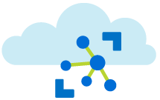






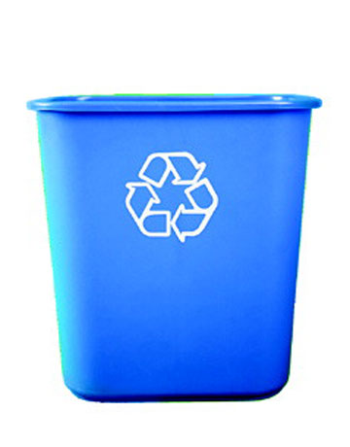
Azure Waste Manage Alert System
Open Weather Map
Azure Function
Things Network to IoT Hub Http Azure Function
Azure Predicative
Analytics
Weather Telemetry
Reference Data Blob
Power BI Embedded
Azure Web App Dashboard
Azure IoT Hub
Azure Stream Analytics
LoraWan
Waste Level Sensor
Service Bus
Queue
SMS Alert Azure Function
Message to clear bin

Slide 3
Telemetry Streaming and Bridging
Things Network to IoT Hub Http Azure Function
Azure IoT Hub
LoraWan
Waste Level Sensor

Slide 4

The Things Network to Azure IoT Hub Gateway
HTTPS POST Azure Function
HTTPS POST URL&Key
(Step 2)
Azure IoT Hub
(Step 1)
Verify TTN by
Application Id
Device id & raw data
(Step 3)
Get Device Key
From Registry
HTTPS GET
Identity Registry
(Step 4)
Data and Command Flow
Build SAS Token
Event Hub
M
(Step 5)
Transform
Raw Data
Per-device command queues
(Step 6)
HTTPS POST
(Step 7)
Submit data
to IoT Hub
HTTPS POST
Waste Sensor
HTTPS RESPONSE

Slide 5
Azure IoT Hub / Things Network Gateway
The Things Network Console Device Simulator
Azure Functions

Slide 6
Stream Analytics

Slide 7
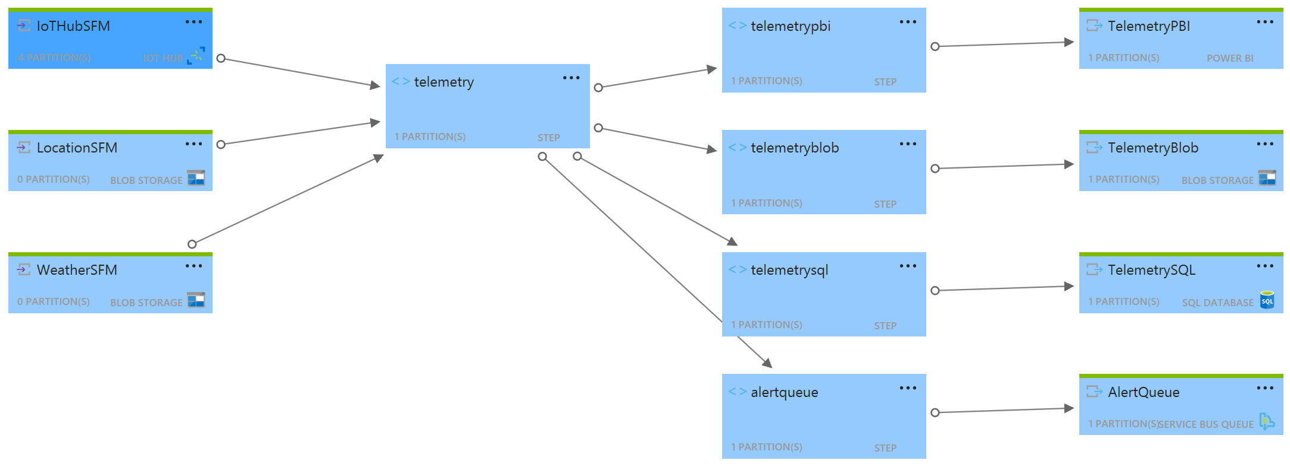
Stream Analytics Job Diagram

Slide 8
Data Enriching and Aggregation: 3 minute Windows
Open Weather Map
Azure Function
Weather Telemetry
Reference Data Blob
Azure IoT Hub
Azure Stream Analytics

Slide 9
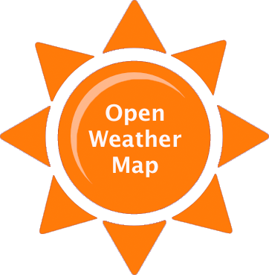
Open Weather Map Reference Data
Azure Blob Storage
Timer Azure Function (15 Mins)
(Step 1)
Reference Data for Stream Analytics
Date/Time Directory Structure must be in UTC
Request Weather
By Location
(Step 2)
Reference-data/weather
Write Ref Data to Blob Storage
yyyy-mm-dd
hh-mm/weather.csv
hh-mm/weather.csv
hh-mm/weather.csv
….
yyyy-mm-dd
hh-mm/weather.csv
….

Slide 10
Stream Analytics Query
WITH Telemetry AS (
SELECT
T.iothub.connectiondeviceid AS DeviceId,
Max(T.EventEnqueuedUtcTime) AS TimeUTC,
Max(DateAdd(Hour, 10, T.EventEnqueuedUtcTime)) AS TimeLocal, -- AU EST UTC + 10
MAX(T.Level) AS Level,
L.Location AS Location,
L.GeopointId AS GeopointId,
W.Temperature AS Temperature,
W.Pressure AS Pressure,
W.Humidity AS Humidity,
W.Precipitation AS Precipitation,
W.Wind AS Wind,
W.Cloud AS Cloud,
W.Weather AS Weather
FROM [IoTHubSFM] T TIMESTAMP BY EventEnqueuedUtcTime
INNER JOIN LocationSFM L ON T.iothub.connectiondeviceid = L.DeviceId
INNER JOIN WeatherSFM W ON W.WeatherID = 'Sydney, AU'
GROUP BY
T.iothub.connectiondeviceid, TumblingWindow(minute, 3), L.Location, L.GeopointId,
W.Temperature, W.Pressure, W.Humidity, W.Precipitation, W.Wind, W.Cloud, W.Weather
)
SELECT * INTO TelemetryPBI FROM Telemetry
SELECT * INTO TelemetryBlob FROM Telemetry
SELECT * INTO TelemetrySQL FROM Telemetry
SELECT * INTO AlertQueue FROM Telemetry WHERE level > 80

Slide 11
Alerting Bin Levels > 80% Full
Azure Stream Analytics
Service Bus
Queue
SMS Alert Azure Function
Message to clear bin

Slide 12
Reporting: On demand and Realtime
Power BI Embedded
Azure Web App Dashboard
Azure Stream Analytics

Slide 13
SMS Alerts Power BI
Demo

Slide 14
Predictive Analytics: Insight
Azure Predicative
Analytics
Azure Stream Analytics

Slide 15
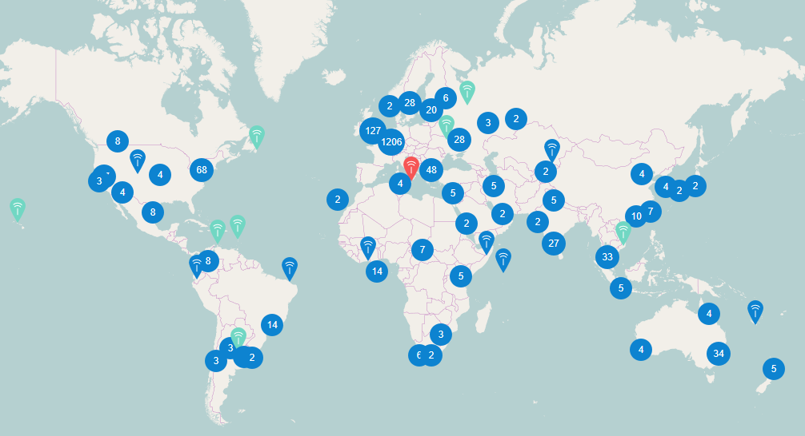
The Things Network and LoraWAN (https://www.thethingsnetwork.org/map)

Slide 17
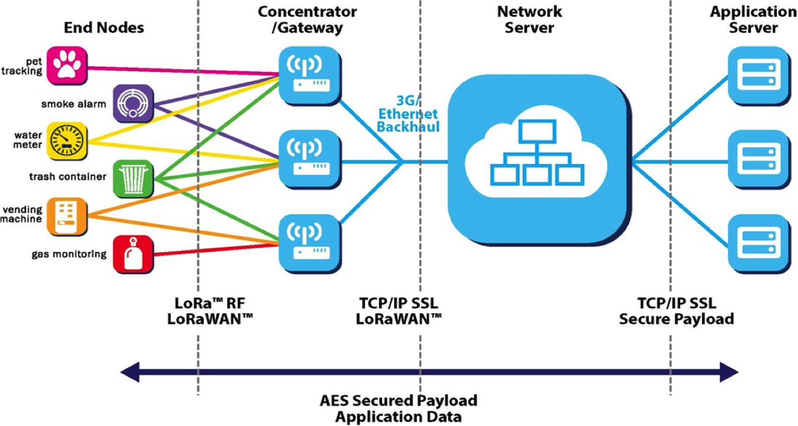
LoraWAN

Slide 18
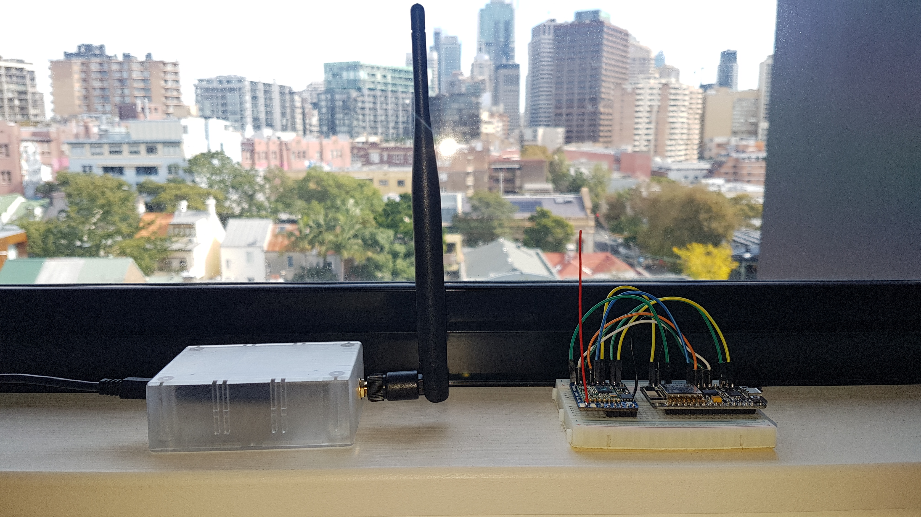
LoraWAN Devices Approx 2km fromTTN GW

Slide 19
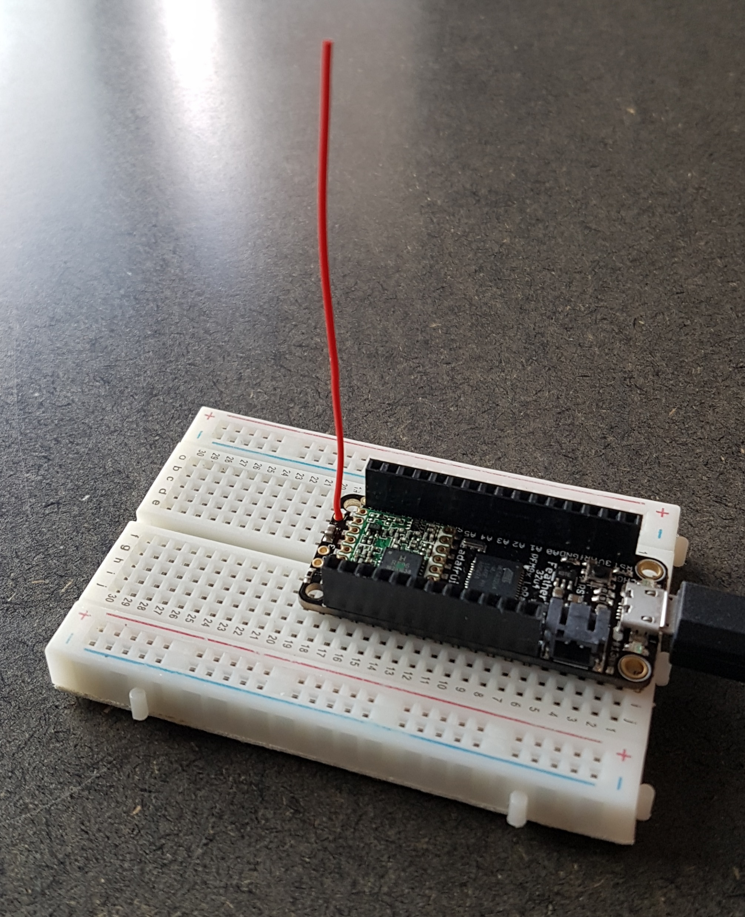
Resources
Adafruit Feather 32u4 RFM95W LoRa Radio - 900MHz
LoraWAN for Australia Frequencies
https://github.com/gloveboxes/arduino-lmic

Slide 20
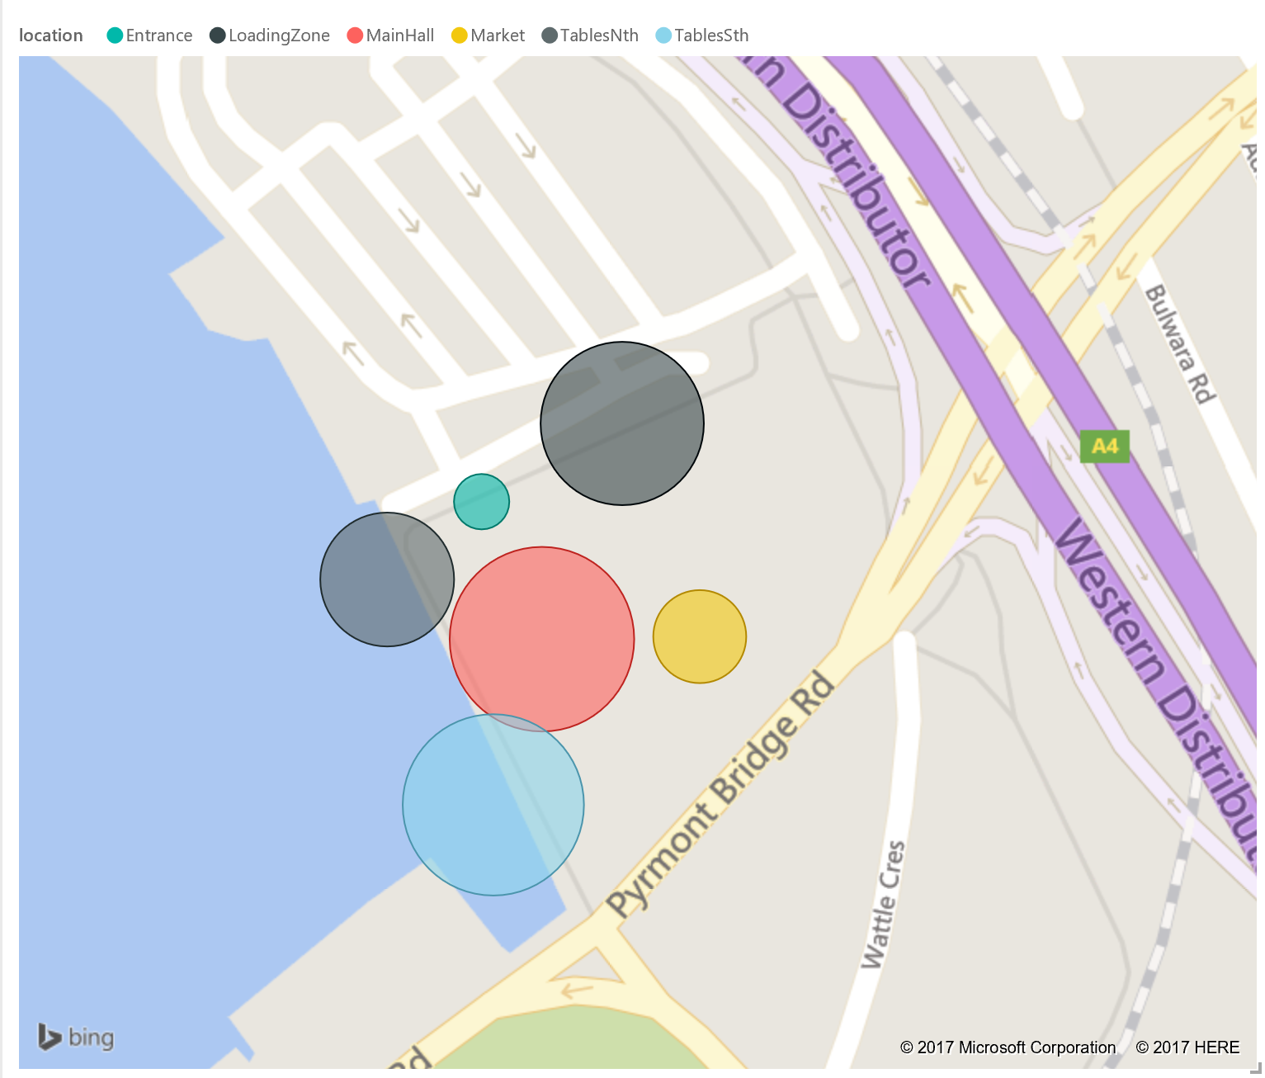
On Demand Reporting

Slide 21
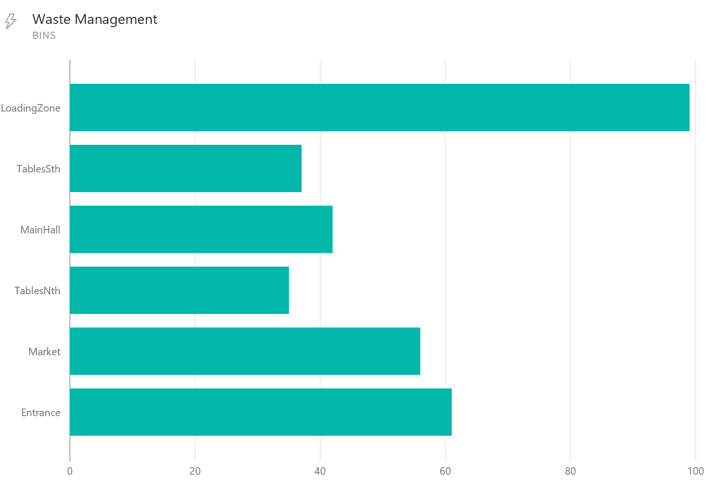
Real Time Reporting

Slide 22
Azure Waste Manage Alert System
Open Weather Map
Azure Function
Things Network to IoT Hub Http Azure Function
Azure Predicative
Analytics
Weather Telemetry
Reference Data Blob
Power BI Embedded
Azure Web App Dashboard
Azure IoT Hub
Azure Stream Analytics
LoraWan
Waste Level Sensor
Service Bus
Queue
SMS Alert Azure Function
Message to clear bin

Slide 23
Demo
Waste Bin Data Simulator
The Things Network Bridge
Power BI
Alerts: SMS (Twillio Cost)

